Slide 1

Bowling european corporative
27.5.-31.5.2025 european championships
PALERMO

Slide 2
Organising Committee
Chairman : Cosimo Zecca
Treasurer/Secretary: Stefania Sisti
Results/Assistant bowling center: Ignazio Cerami - Arcangelo Priulla
Logistic manager: Vincenzo Lo Cascio- Il Tuareg Tour Operator
Techn. Organisation: Staff Fisbb

Slide 3
Fees
Tournament fee:
300 € Teams
150 € Double/Mixed
Players Party:
50 € person
Saturday night at “Città Del Mare Terrasini (Pa)”

Slide 4
dEADLINES
1st of March 2025:
Closing date for the official Entry Form
Closing date for hotel reservations
15. March 2025:
Closing date for all the entry forms and payments for participation and party

Slide 5
Payments entry fee
NO payment or bank charges to be passed to Italian Organising Committee (FISBB)
Team Payments : One payment per country.
Country and number of teams of Team- MX- LD and MD on Reference Field
(for example: Italy 8Team- 3LD- 2MD- 2MX)
Bank details for the Entry Fee:
Account name: FISBB – Bank: Intesa Sanpaolo
IBAN: IT32L0306909606100000193199
BIC: BCITITMM

Slide 6
TRANSPORT From airport G. FALCONE
TO THE HOTEL
Federations who book their stay in Città del Mare through the FISBB/IL TUAREG convention, will benefit from free transfers from FALCONE BORSELLINO airport to the Città del Mare hotel and departure.

Slide 7
Travelling
By car:
  Please keep in mind, that there is heavy traffic in city centre
Parking at bowlingcenter
  Palermo: Free parking with a free offer
  Bagheria: there is an agreement with a car park or along the road
DISTANCES IN KILOMETRES:
HOTEL CITTA’ DEL MARE – AEROPORTO = KM. 19
HOTEL CITTA’ DEL MARE – LA FAVORITA = KM. 32
HOTEL CITTA’ DEL MARE – BAGHERIA = KM. 51

Slide 8
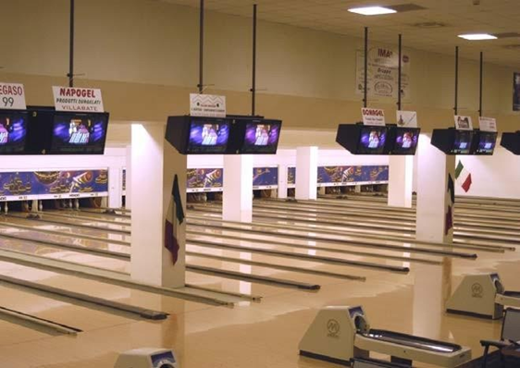
Bowling centers
Palermo – Bowling La Favorita
Viale del Fante, 1 - 90143 Palermo (PA) tel. 091 6373130
20 lanes
Bowling Bagheria
Via Angiò, 113 - 90011 Bagheria (PA) tel. 091 969213
24 lanes
Equipment Storage
Bowling equipment will be stored in a designated area at the bowling center.
Proshop
Services are provided inside the bowling center

Slide 9
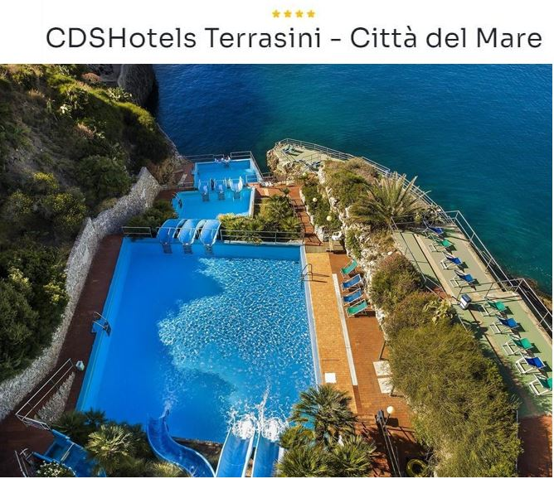
Hotel
CDS HOTELS TERRASINI Period: 27.05 - 02.06.2025
https://cdshotels.it/gallery-cdshotels-terrasini/
Superior sea view rooms with breakfast and dinner
- Double Room 2 adults.........................................................................€ 190 per day
- Double Room Single Use 1 adult DUS........... .....................................€ 120 per day
- Triple Room 2 adults and 1 child under 12........................................ € 190 per day
-Triple Room 2 adults and 1 young 12/16 years old...........................€ 215 per day
- Triple Room 3 adults...............................................................................€ 265 per day
- Quadruple room 2 adults and 2 children under 12...........................€ 240 per day
- Quadruple room 2 adults and 1 child under 12 + 1 young 12/16....€ 240 per day
- Quadruple room 3 adults and 1 child under 12.................................€ 265 per day
- Quadruple room 3 adults and + 1 young 12/16.................................€ 290 per day
- Quadruple room 4 adults ......................................................................€ 335 per day

Slide 10
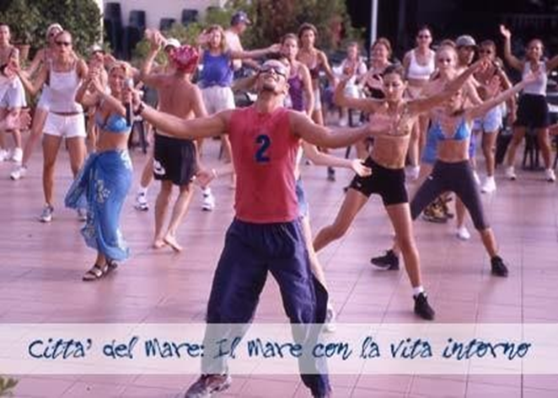

SPECIAL HALF BOARD includes
- CHECK-IN 17:00 - CHECK-OUT 10:00
- Welcome drink at check-in
- Porterage service
- half board with buffet dinner (water, soft drinks, beer and wine)
- baby bottle with fresh products
- mini club and junior club at set times in Nello Land
- daytime sports fields, subject to availability
- Toboggan and Lido Pontone equipped with parasols and sun loungers,
- Gulf swimming pool
- Olympic swimming pool,
- evening piano bar,
- indoor parking

Slide 11
Registration and Payment Policy
By 01 March 2025: guest/athlete list for hotel per nation should be sent to: elena@iltuareg.it
The Tuareg will issue a pro-forma invoice to each nation to which we ask you to send all invoicing data
By 15 March 2025: Payment, including Gala dinner, to the following beneficiary:
TUAREG SRL CREDEM IBAN IT59N030320460100000791 SWIFT BACRIT22PAL
CAUSAL: BEC 2025 and COUNTRY NAME
Cancellation policies
No penalty for cancellations received by 01 March 2025
10% penalty for cancellations received by 15 March 2025
25% penalty for cancellations received by 30 March 2025
50% cancellation fee for cancellations received by 30 April 2025
80% cancellation fee for cancellations received by 13 May 2025
100% penalty from 14 May 2025 and in case of no-show
GALA DINNER WITH MUSIC AND SHOWS
€ 50 ADULTS
€ 25 YOUNG UNDER 16
FREE CHD UNDER 3 YEARS

Slide 12
Hotel reservations
We recommend Hotel CDSHOTELS TERRASINI (Città del Mare)
The hotel must be booked on mail
Email: elena@iltuareg.it
Reservation code: BOWLING + companyname
Deadline 01.03.2025

Slide 13
results
The bowling center are using Online Scoring.
Results are shown on screens and will be updated to the websites right after squads.

Slide 14
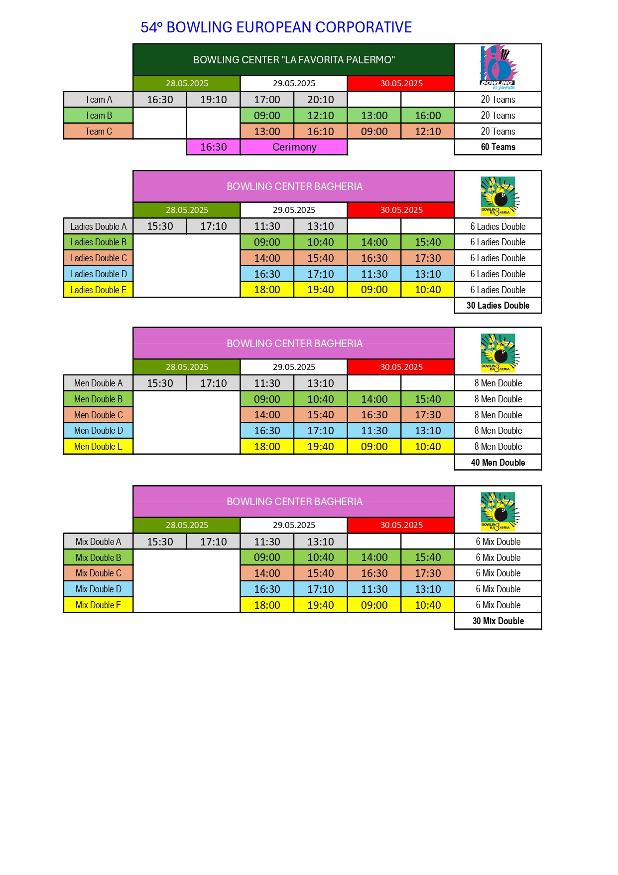

Slide 15
Bec meeting
FRIDAY 30th of May 2025
At 09:45 am
Hotel: CDShotels Citta del Mare Terrasini

Slide 16
LivestreamING
http://QubicaAMF - Online Score

Slide 17
Welcome to
SICILY

